Slide 1
Crypto App with Shiny
Project by Iryna Duda

Slide 2
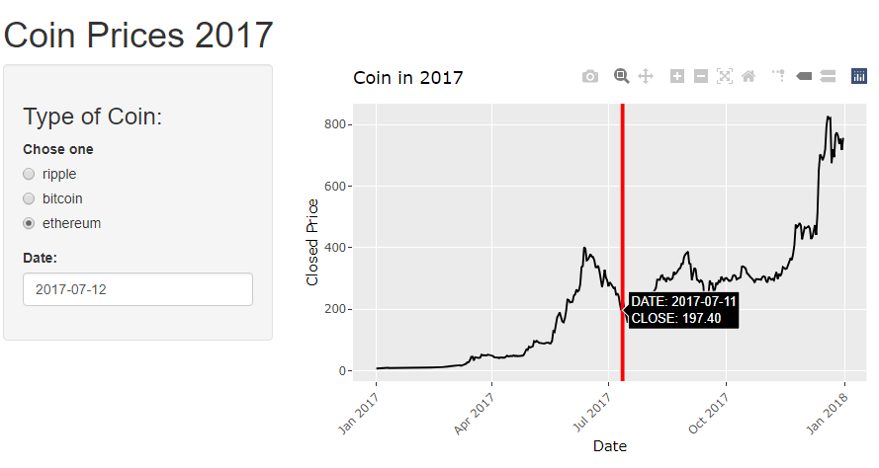
Purpose of the App – to find the closed stock prices of the crypto coins on a same a day

Slide 3
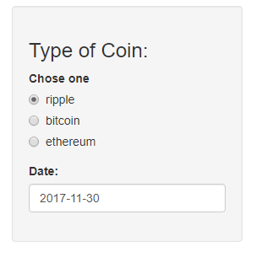
Interactive Input parts:

Slide 4
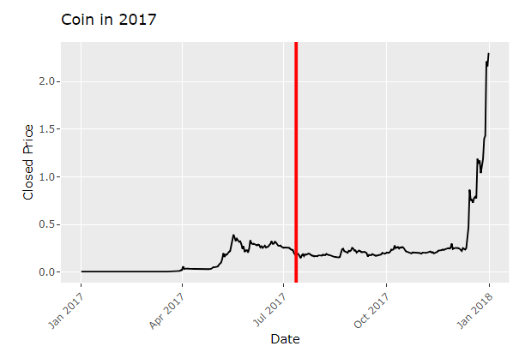
Plot output with Interactive Red Line called by selected a date

Slide 5
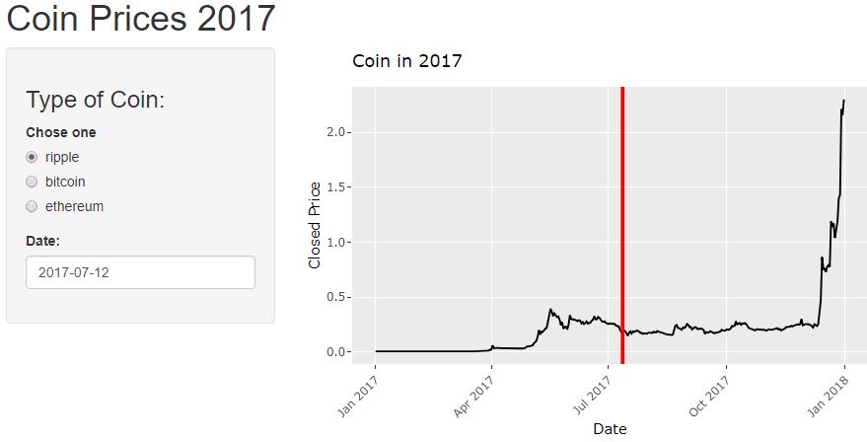
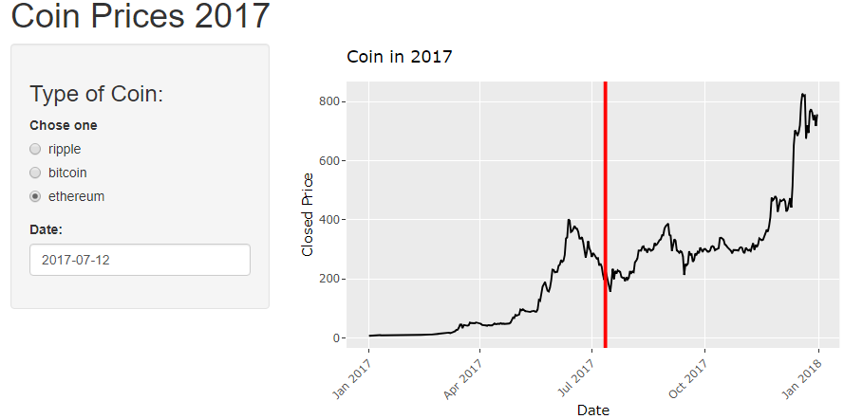
Interactive line chart that dependent on coin choice:

Slide 6
Interactive label supported by Plotly library

Slide 7
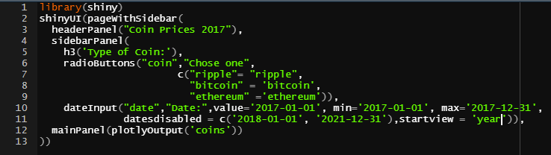
UI.R code

Slide 8
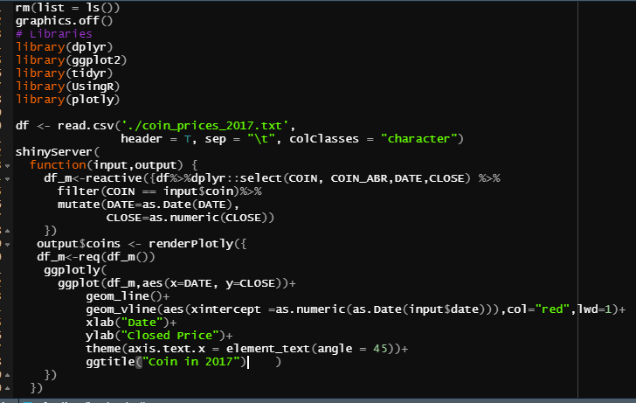
Server.R code

